Slide 1
CS513 GEOSPATIAL VISION HW2
PROBE DATA ANALYSIS FOR ROAD SLOPE
Group: Nikita Wali ,
Soundarya Hiriyanna Matti,
Srihari Gururaj

Slide 2
Outline
OVERVIEW
AIM
INTRODUCTION
Probe Data
Link Data
Map matching
Slope calculation
Evaluate the Derived slopes with surveyed road slopes in Link data
Result
Conclusions

Slide 3
OVERVIEW
Probe points are collected in Germany over a period of 9 months, for which the probe points are map-matched to road links to derive the road slope.
The derived road slopes are evaluated with the surveyed road slope in the link data file
Probe Data is generated by monitoring the position of individual moving objects over space and time.

Slide 4
AIM
Implement the map-matching of probe points to road links.
To derive road slope for the links given in the link data file.
As an application of Probe Data we derive road slope for each road link.
Calculate the slope of links based on the information available in map.
Match these probe points and verify our results against given slope data in link file.

Slide 5
INTRODUCTION
Probe Data
Probe data is the data which is generated by monitoring the position of individual vehicles like cars, buses, trains etc. over space and time using dedicated probe vehicles, mobile phones, sensors etc.
Data thus obtained is a time series of locations. It is in the form of (Latitude, Longitude, TimeStamp).

Slide 6
INTRODUCTION
Link Data
The link data is information of road segments (links).
It consist of data for the links that probe points can be map-matched to.
It consist of linkPVID, length, directionOfTravel etc

Slide 7
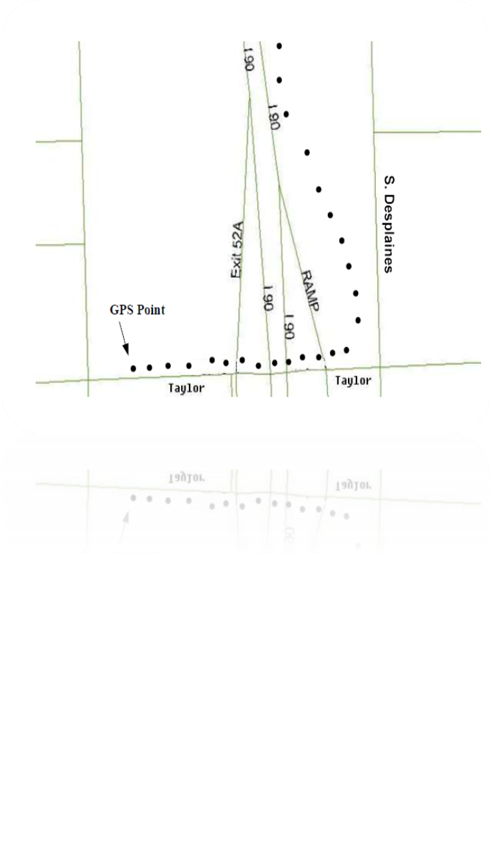
INTRODUCTION
Map matching
The GPS probe data collected is mostly inaccurate and can be accounted to the noise and sparseness of the data, which paves way to the concept of map matching where in we try and map the individual probe data points to the closest link/segment which forms a part of the complete path. This process is termed as map-matching.

Slide 8
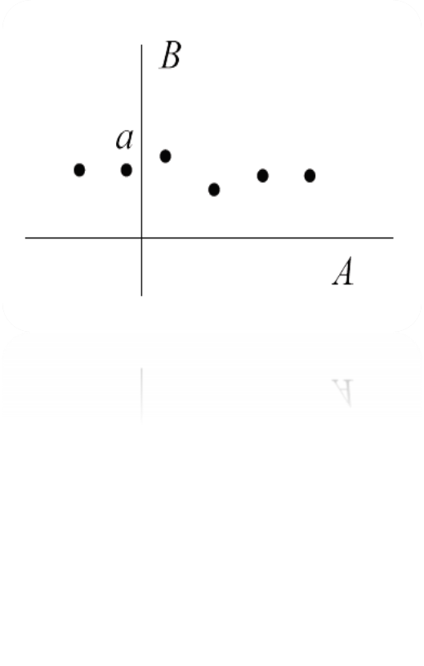
INTRODUCTION
Map matching
Global algorithms batch process the entire input trajectory before generating the solution.
Incremental/online algorithms employ localizing strategies that divide the input trajectory into smaller segments and process them sequentially, sometimes resulting in a suboptimal solution.
For each probe point compute the perpendicular intersection of the probe point’s projection onto each segment/link.

Slide 9
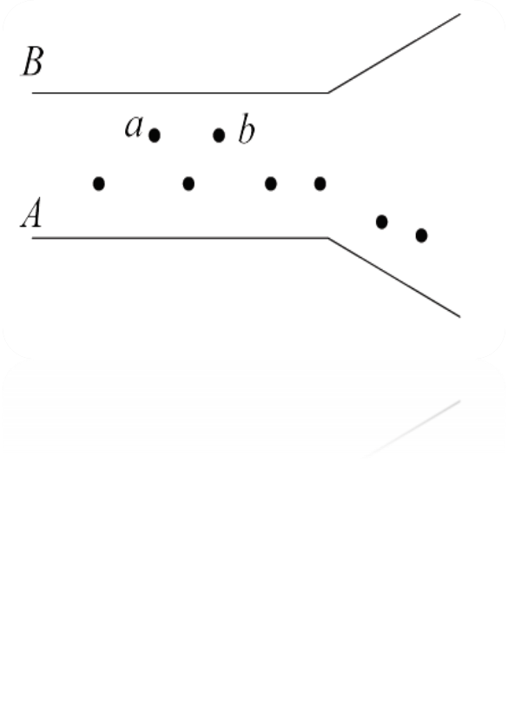
INTRODUCTION
Map matching
Now compute the distance so obtained for all the links with respect to each probe point’s coordinates.
Select the shortest distance and form pairs of such links and probe points.
At the end of this process we would end up obtaining dictionaries with link id as the key and probe point IDs as the values.
So the Map Matching comes to an end at this point in time.

Slide 10
INTRODUCTION
Slope calculation
We have used the Haversine formula to determine the great circle distance between any two points on a sphere given their latitude and longitude.
For each set of probe points associated with a link, we compute the slope between each pair of points.
Haversine Formula: It determines the great-circle distance between two points on a sphere given their longitudes and latitudes.
a = sin²(Δφ/2) + cos φ₁ ⋅ cos φ₂ ⋅ sin²(Δλ/2)
c = 2 ⋅ asin( √a )
R = 6371*1000
a = square of half of the chord length between the points
c = angular distance in radians
R = radius of Earth in km
φ = latitude in radians
λ = longitude in radians

Slide 11

Slope calculation
‘α’ is the slope angle between the consecutive probe points paired with the link/segment.
We thus calculate the slopes between all the consecutive pairs of points and take an average of these values to obtain a consistent slope for a segment or link.
‘d’ is the haversine distance between p1 and p2 computed as shown in the following slide
The slope between two consecutive points (P1, P2) is = 𝑅𝐼𝑆𝐸/𝑅𝑈𝑁 𝑖.𝑒. (𝑌2−𝑌1)/(𝑋2−𝑋1)
where p1(x1,y1) p2(x2,y2) are two points.
 |  | h1-h2 |  | α
 |  |  | h1 | d | h2
P2(x2,y2)
P1(x1,y1)

Slide 12
Slope calculation
SLOPE = tan α = (Opp/Adj)
Where,
Opp = difference between the heights of the probe points P1 and P2 which can be computed using the data in the link segment csv file given.
Adj = haversine distance between he probe points under consideration.
Eventually an average of all the slopes corresponding to a link/segment is computed which is treated as a generalized slope value.
These values are populated into a .csv file juxtaposing with the given mean values of the slopes which can be observed in the attached csv files.

Slide 13
STEPS
Extract Data and Load into Lists
Find Haversine distance between adjacent probe points
Spatial analysis: Observation and Transmission probability
Calculate the slope between adjacent probe points
Map-Matched Probe data points to corresponding Link
And output
Temporal Analysis for better result
Calculate mean and cumulative slope for each link
Compare the calculated and given slope values
Print and store the results

Slide 14
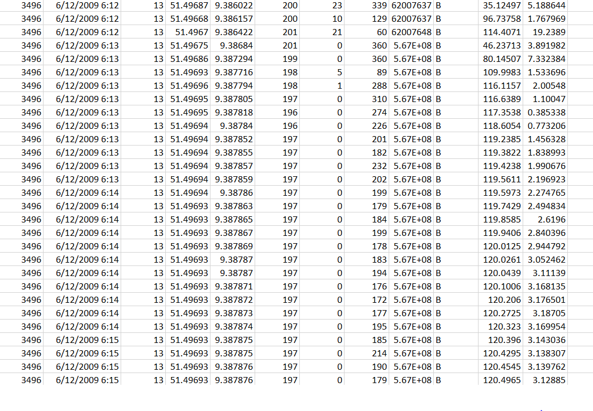
RESULT
Output :MatchedPoints.csv (10000 probes)
sampleID, dateTime, sourceCode, latitude, longitude, altitude, speed, heading, linkPVID, direction, distFromRef, distFromLink

Slide 15
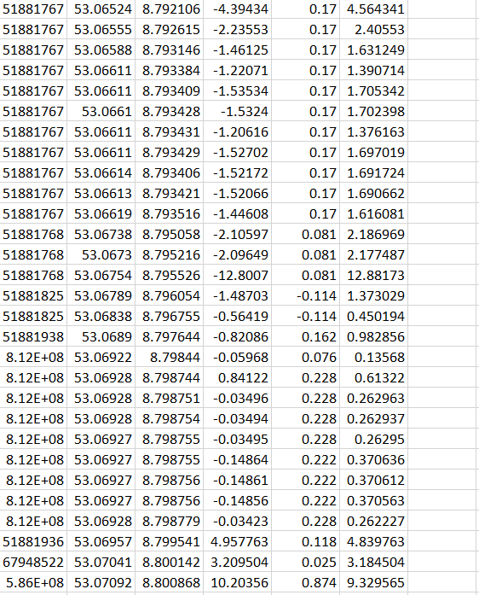
RESULT
Output : LinkSlopeAndEvaSlope.csv
linkPVID, latitude, longitude, evaSlope, slope, abs(evaSlope - slope)

Slide 16
CONCLUSIONS
From the result. we get some matching slope values when we compare the given and the calculated data.
Our observation from this assignment was that, if we get enough probe points for a link, then we are able to calculate the slope of the link to an acceptable precision.
Highly precise GPS traces are rarely available.
Dense trajectories are costly for live transmission and storage.
For future work, we can explore the design of map-matching algorithms with dynamic parameters that detect and adapt to different environmental settings,
A better approximation of the actual traveled paths may improve map-matching accuracy.
A lot of data in the dataset cause very long time to calculate all of them.

